Slide 1
NEWLINK CABLING SYSTEMS
Newlink…A Complete Solution!

Slide 2
¿Who are we?
NEWLINK Cabling Systems is a global leader with over 20 years experience in manufacturing and marketing copper cables, fiber optics, and accessories for the transmission of voice, data, and video.
We offer a portfolio of world-class products for structured cabling, data networking, instrumentation and industrial control, security and telecommunications infrastructure

Slide 3
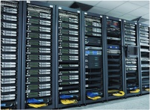
Why is Newlink a Complete Solution?
We are a Complete Solution…
Our product portfolio includes everything needed for a successful installation, under the same brand and the same guarantee. Copper cables and fiber optics, accessories and connectivity products for communications infrastructure
Solution for Complex Projects
Newlink has been chosen in more than 600 projects successfully implemented over the last five years in Latin America and the Caribbean, in various sectors such as Government, Health, Banking and Insurance, Airports, Education, Industry and Commerce.

Slide 4
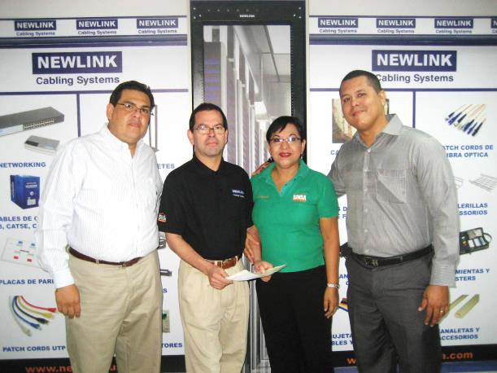
Why is Newlink a Complete Solution?
Customer satisfaction
We have a satisfaction rate of 95%, the highest in the industry, with satisfied customers by the quality of products, the service provided by our team, delivery, warranties and product variety offered
Certifications and Demand Generation Activities
More than 100 Certification courses to hundreds of customers and demand generation programs developed with our business partners in Latin America and the Caribbean.
Best Price/Performance of the Market
Our prices adjust to market needs and include an extended warranty of 25 years, Verified UL certification and a portfolio of high quality products

Slide 5
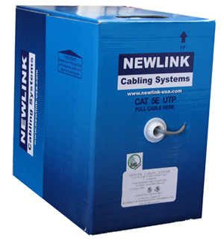
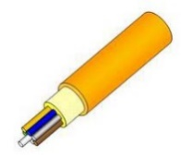
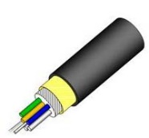
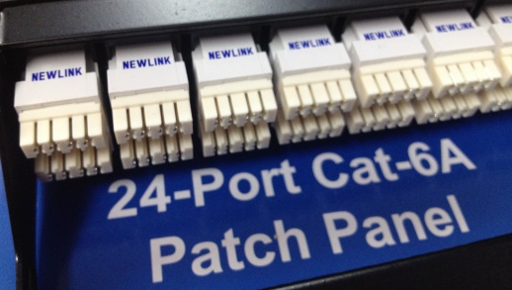
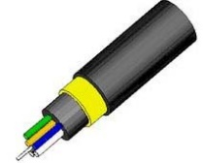
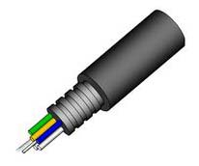
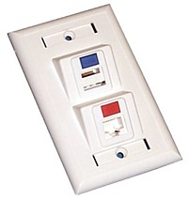
Copper and Fiber Optic Cables
Cables UL Verified
Cat 3, 5E, 6 & 6A
UTP, STP & Coaxials
Indoor and Outdoor with Gel
Connectivity: Patch Cords, Patch Panels and connectors
OS1 & OS2
OM1, OM2, OM3 & OM4
ADSS & Armored
Indoor and Outdoor
ODFs, Pigtails, Patch Cords and connectivity (SC, ST, LC, FDDI, MTRJ)

Slide 6
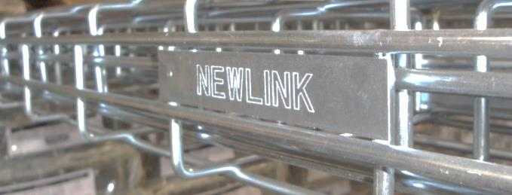
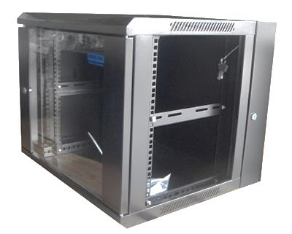
Cable Trays, Cabinets and Racks
Cable trays – Infrastructure
Flexible metal trays and mounting hardware. The most versatile solution for growing infrastructure of cable support data, voice, video, power, security, instrumentation and control.
Cabinets and Racks
Free Standing and wall cabinets for data, telephony and Servers, with perforated or glass doors, power sockets 8, 10 and 20 outputs, horizontal and vertical organizers .
Open racks with 2 or 4 poles

Slide 7
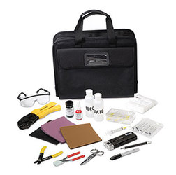
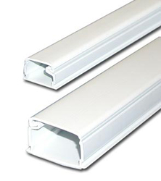
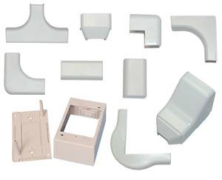
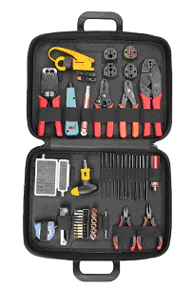
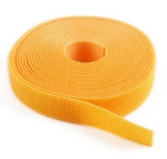
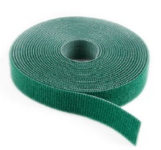
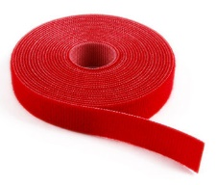
Raceways and Accessories
PVC raceways fire retardant
Surface boxes
Other fittings
Toolkits
Mounting Accessories
Consumable supplies

Slide 8
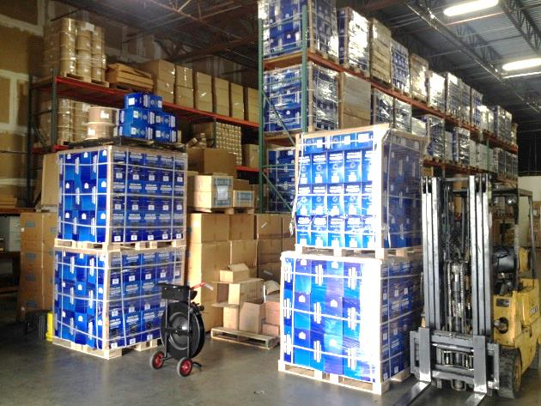
Immediate Delivery and Local Stock Available
We offer immediate delivery of products from our distribution center in Medley, Florida.
Operating in each country, our Authorized Representatives offer specific local inventories to meet the needs of their markets.
Our automated process ensures shipment accuracy.

Slide 9
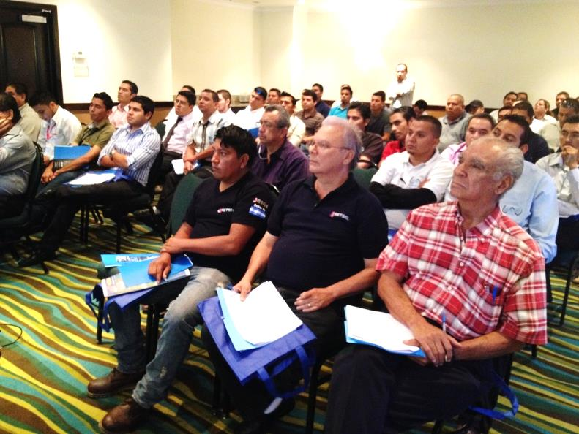
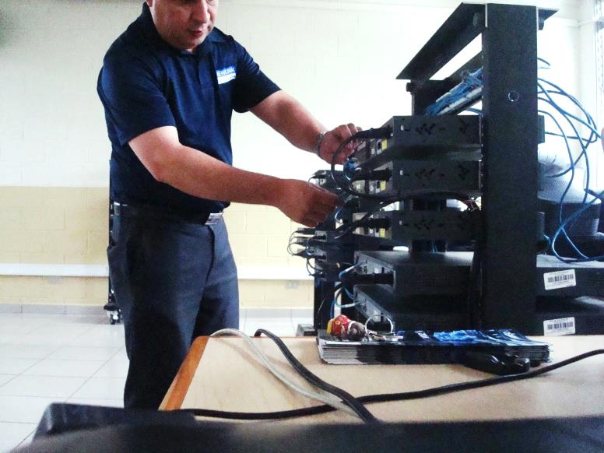
Customer Oriented Certifications and Trainings
Training for our business partners and authorized installers.
Technological breakfasts
Training to final consumers
Consultation in design

Slide 10
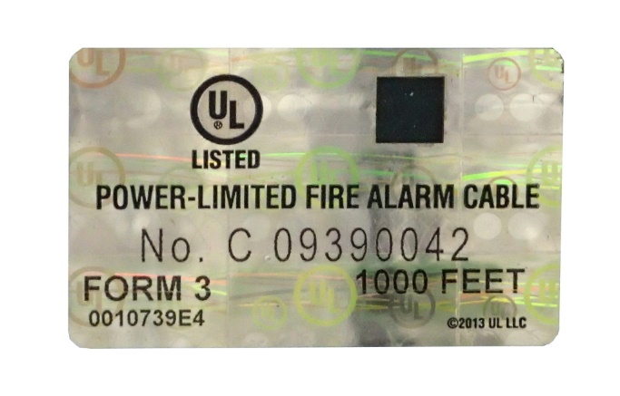
UL Verified / UL Hologram
We have the strictest Performance Certification supporting the categories 5E, 6 and 6A UL Verified .
We do not limit our UL Certifications to jacket types CM, CMR, CMX.
All our cable reels Category 5e, 6 and 6A have the UL holographic ID . Providing security against non certifiable or replica products.
NEWLINK protects its customers’ investment.

Slide 11
Extended Warranty
We certify the performance of our structured cabling solutions according to ISO / IEC 11801 and ANSI / TIA standards for Category 5e, 6 and 6A.

Slide 12
Some of our customers…
More than 2,500 points of NEWLINK Cat-6 cabling installed and certified. Ecuador’s Post Office
400 schools in the Dominican Republic were interconnected with a Newlink infrastructure solution

Slide 13
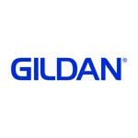
Some of our customers…
Installation of NEWLINK fiber optic cable high density in Augusto Sandino Airport
AUGUSTO C. SANDINO NICARAGUA
NEWLINK cabling solution in Cat- 5E for industrial automation in Gildan Honduras

Slide 14
¿Porque Newlink es la solución ideal ?
Somos una Solución Completa
Nuestro portafolio de productos incluye todo lo necesario para una instalación exitosa, bajo una misma marca y una misma garantía. Cables de cobre y fibra óptica, accesorios de conectividad y productos de infraestructura de comunicaciones
Solución para Proyectos Complejos
Más de 600 proyectos ejecutados exitosamente durante los últimos 5 años en Latinoamérica y El Caribe, en sectores diversos como Gobierno, Salud, Banca y Seguros, Aeropuertos, Educación, Industria y Comercio.

Slide 15
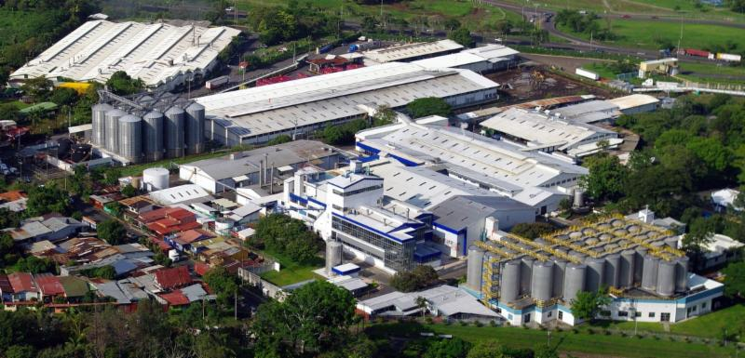
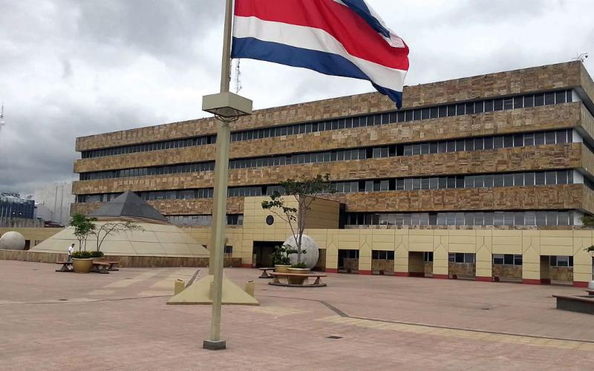
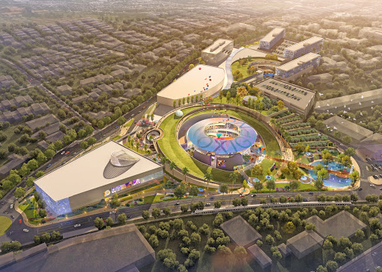
Some of our customers…
Cervecería Costa Rica
Poder Judicial de Costa Rica
Playground Oxigeno Heredia

Slide 16
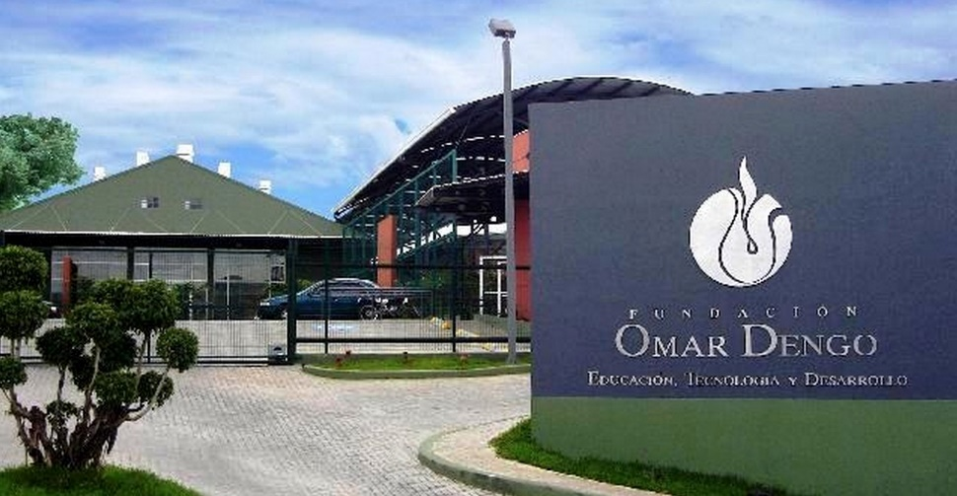
Some of our customers…
Fundación Omar Dengo y
Ministerio De Educación Pública Costa Rica

Slide 17
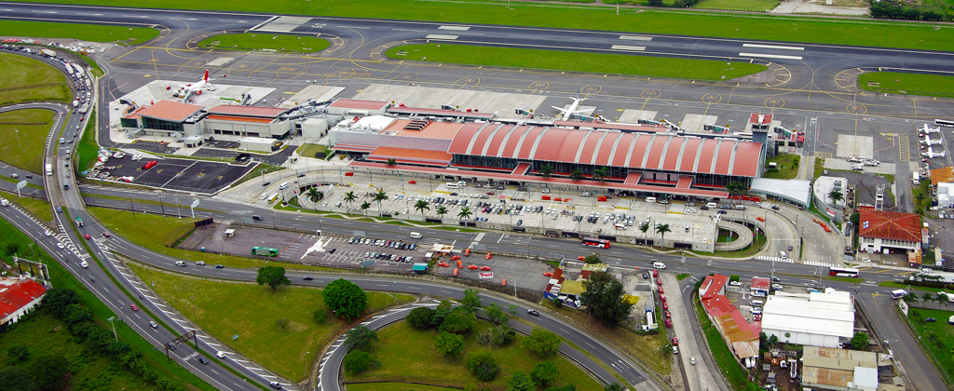
Some of our customers…
Colegio Humboldt Costa Rica
Aeropuerto Internacional Juan Santa María – Costa Rica

Slide 18
NEWLINK CABLING SYSTEMS
Newlink… A Complete Solution!

